Slide 1
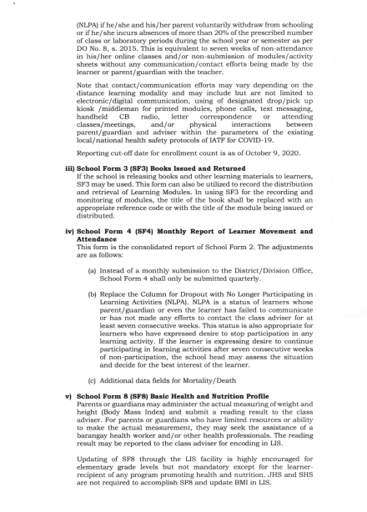
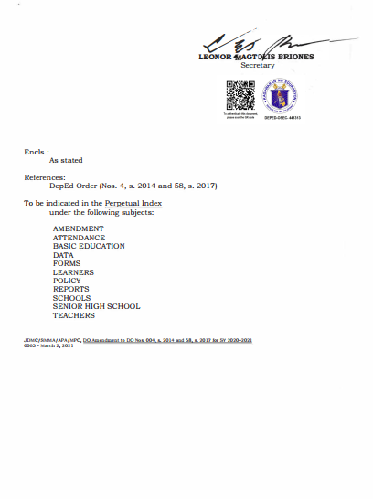
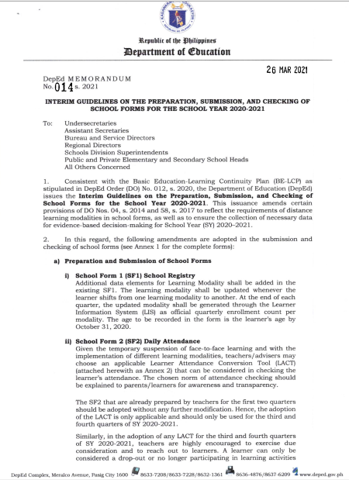
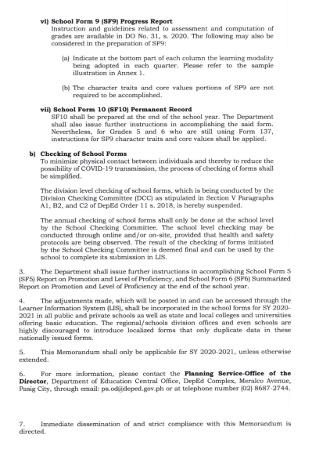
DepEd Memorandum 14, s 2021

Slide 2
INTERIM GUIDELINES ON THE PREPARATION, SUBMISSION, AND CHECKING OF
SCHOOL FORMS FOR THE SCHOOL YEAR 2O2O - 2O21

Slide 3
To reflect the requirements of distance learning modalities in school forms, as well as to ensure the collection of necessary data
for evidence - based decision - making for School Year 2O2O - 2O21

Slide 4
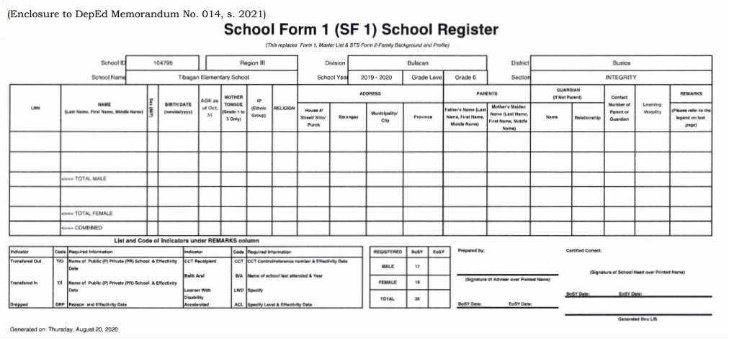
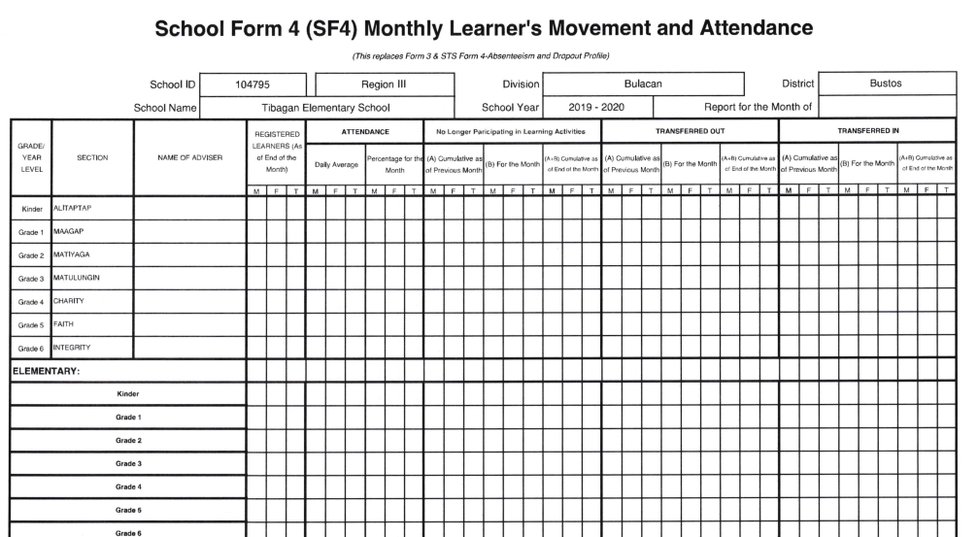
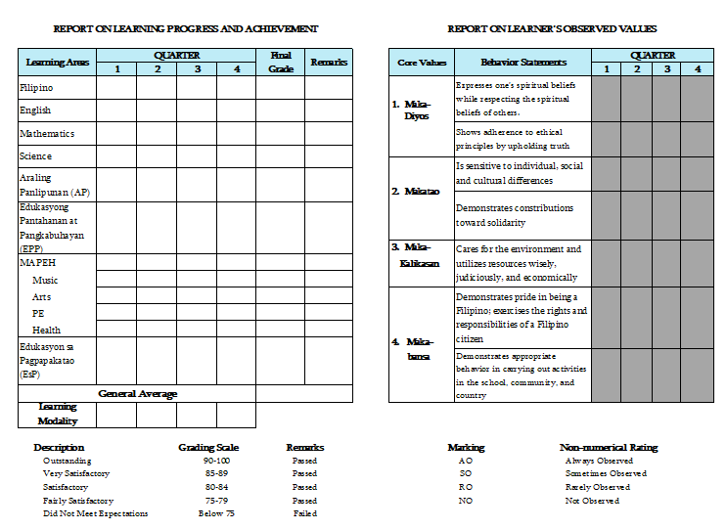
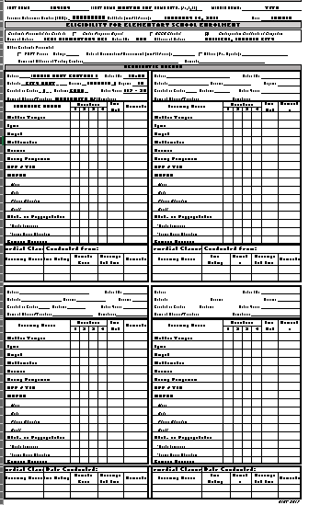
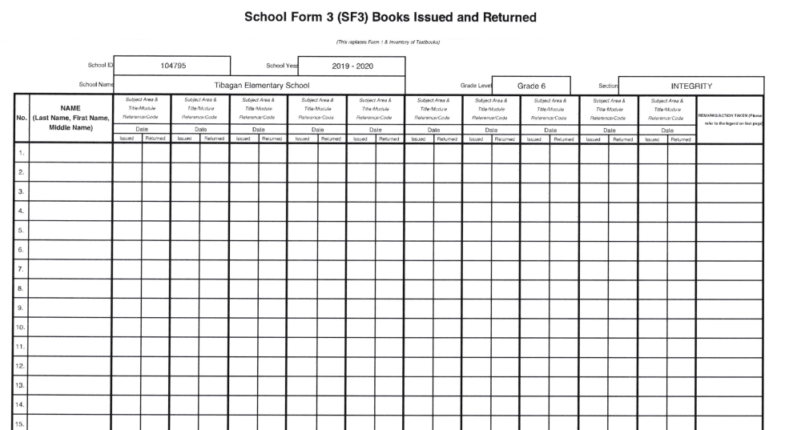
Different School Forms
SF - 1
SF - 4
SF - 2
SF - 9
SF - 3
SF - 10

Slide 5
Preparation
of
School Forms

Slide 6
Different School Forms
SF - 1

Slide 7
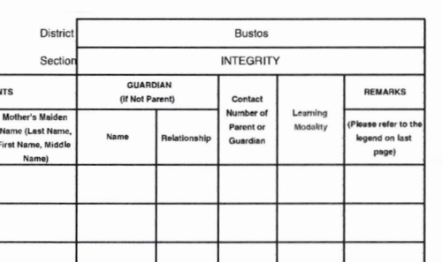
Different School Forms
SF - 1

Slide 8
Different School Forms
SF - 2

Slide 9
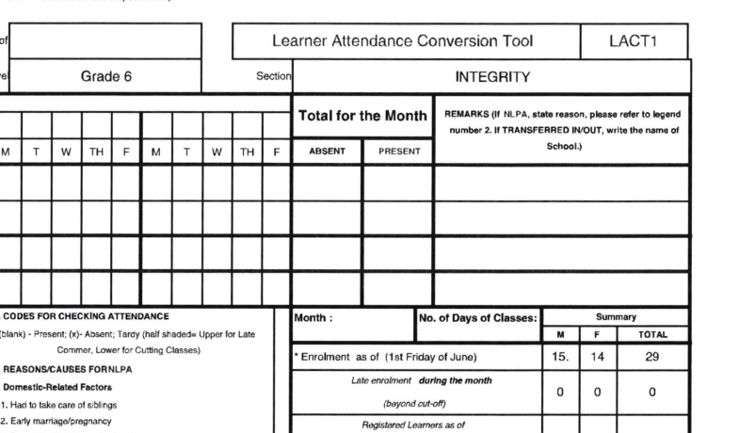
Different School Forms
SF - 2

Slide 10
Learner Attendance Conversion Tools
LACT 1
LACT 2
LACT 3

Slide 11
LACT 1
Is use for converting learner’s attendance in an online class by the used of an electronic digital flatform or apps

Slide 12
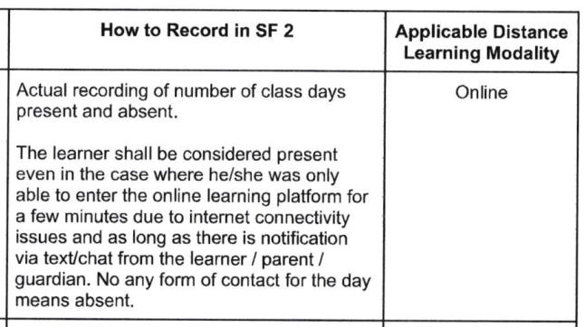
LACT 1

Slide 13
LACT 2
Converting communication effort with the learners / parents into attendance as program in WHLP

Slide 14
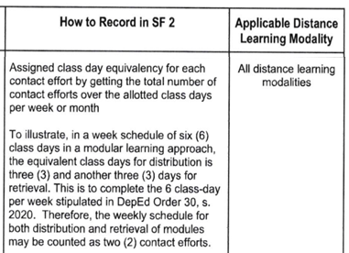
LACT 2

Slide 15
LACT 2

Slide 16
LACT 3
Converting the submission of outputs into learner’s attendance regardless of score.

Slide 17
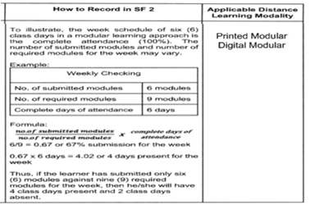
LACT 3

Slide 18
LACT 3
number of submitted modules = 6
required modules to be submitted = 9
÷ 9 = 0.67 or 67%
0.67 x 6 days = 4.02 or 4 days attendance

Slide 19
Learner Attendance Conversion Tools
LACT 1
LACT 2
LACT 3

Slide 20
Learner Attendance Conversion Tools
Implementation is effective starting 3rd to 4th grading

Slide 21
A learner can only be
considered a drop - out or no longer participating in learning activities (NLPA) if he/she and his/her parent voluntarily withdraw from schooling or if he/ she incurs absences of more than 2O% of attendance during the school year per DO No. 8, s. 2O15

Slide 22
Different School Forms
SF - 3

Slide 23
Different School Forms
SF - 4

Slide 24
Different School Forms
SF - 9

Slide 25
SF - 9
Instruction and guidelines related to assessment and computation of
grades are available in DO No. 31, s. 2020.

Slide 26
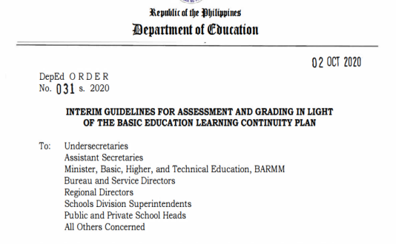
SF - 9
DO No.31, s. 2020.

Slide 27
SF - 9
DO No.31, s. 2020.

Slide 28
SF - 9
DO No.31, s. 2020.

Slide 29
SF - 9
DO No.31, s. 2020.

Slide 30
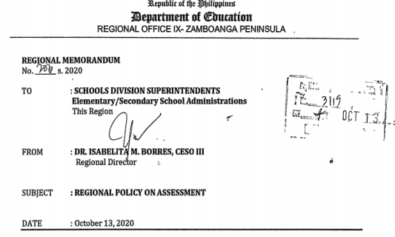
SF - 9
RM 206, s. 2020.

Slide 31
SF - 9
RM 206, s. 2020.

Slide 32
SF - 9
DM 14, 2021

Slide 33
SF - 9
(a) Indicate at the bottom part of each column the learning modality being adopted in each quarter.

Slide 34
Different School Forms
On-line Class
Modular (Printed)
Blended
On-line&SLM
Modular (Digital)
SF - 9

Slide 35
SF - 9
(b) The character traits and core values portions of SF9 are not required to be accomplished.

Slide 36
Different School Forms
SF - 9

Slide 37
Different School Forms
SF - 9

Slide 38
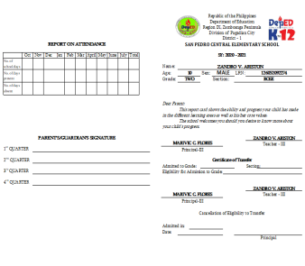
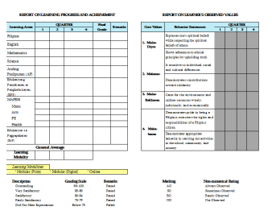
Different School Forms
SF - 9

Slide 39
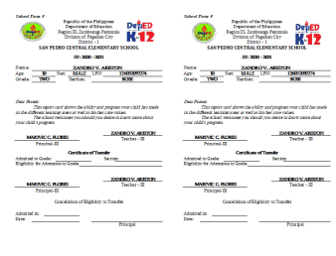
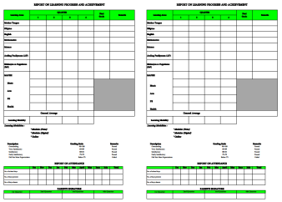
Different School Forms
SF - 9

Slide 40
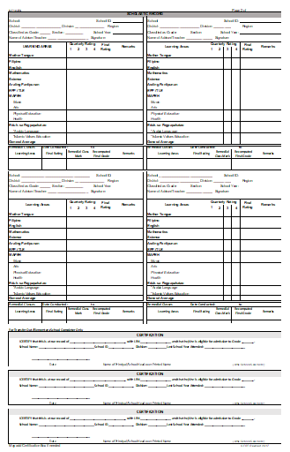
Different School Forms
SF - 10

Slide 41
Remarks
What are the guidelines in filling on the remarks

Slide 42
SF – 9 & 10
DM 14, 2021

Slide 43
SF – 9 & 10
DO 31, 2020

Slide 44
Remarks

Slide 45
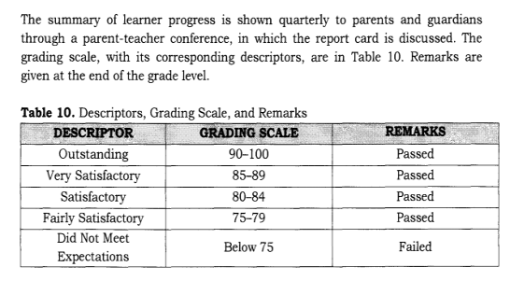
Remarks

Slide 46
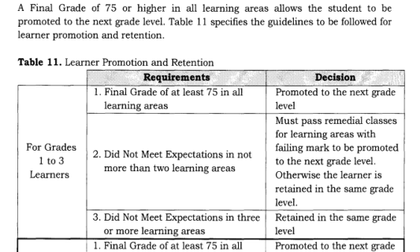
Remarks

Slide 47
Different School Forms
Passed
Passed
Passed
Passed
Passed
Passed
Passed
Passed
79
Modular Printed
Modular Printed
Modular Printed
Modular Printed
SF - 9

Slide 48
Different School Forms
SF - 9

Slide 49
Checking
of
School Forms

Slide 50
SCC
The school head as the chair of the SCC has the discretion to reconstitute the members of the committee, except . . .

Slide 51
SCC
Except for the LIS Coordinator as one of the two co-chairs of the SCC…

Slide 52
SCC
Checking may be conducted through online and/or on-site, provided that health and safety protocols are being observed.

Slide 53
SCC
Forms to be checked:
=SF1
=SF2
=SF3
=SF4
=SF9
=SF10

Slide 54
Submission
of
School Forms

Slide 55
SCC
After checking of school forms, the SCC shall submit reports to the DCC Chair on or before July 30, 2021, ( DM PHROD 2021-0476)

Slide 56
SCC
Forms to be submitted:
=SF4 (June 2021)
=SF5
=SF6
=SFCR1

Slide 57
Open Forum

Slide 58
Thank you for listening

